Slide 1
ACADEMIC PROJECT REVIEW
RAILWAY
RESERVATION
SYSTEM
PROPOSED DESIGN · SEARCH TO BOOKING

Slide 2
01 · SCOPE
A CLEAR PROJECT TITLE SETS THE SCOPE
Project
Railway Reservation System
Stage
Proposed design; no working prototype is claimed.
Review focus
A digital journey for finding and reserving train travel.
Rubric
Clarity of project title · 10 points
PROJECT REVIEW · 10 POINTS

Slide 3
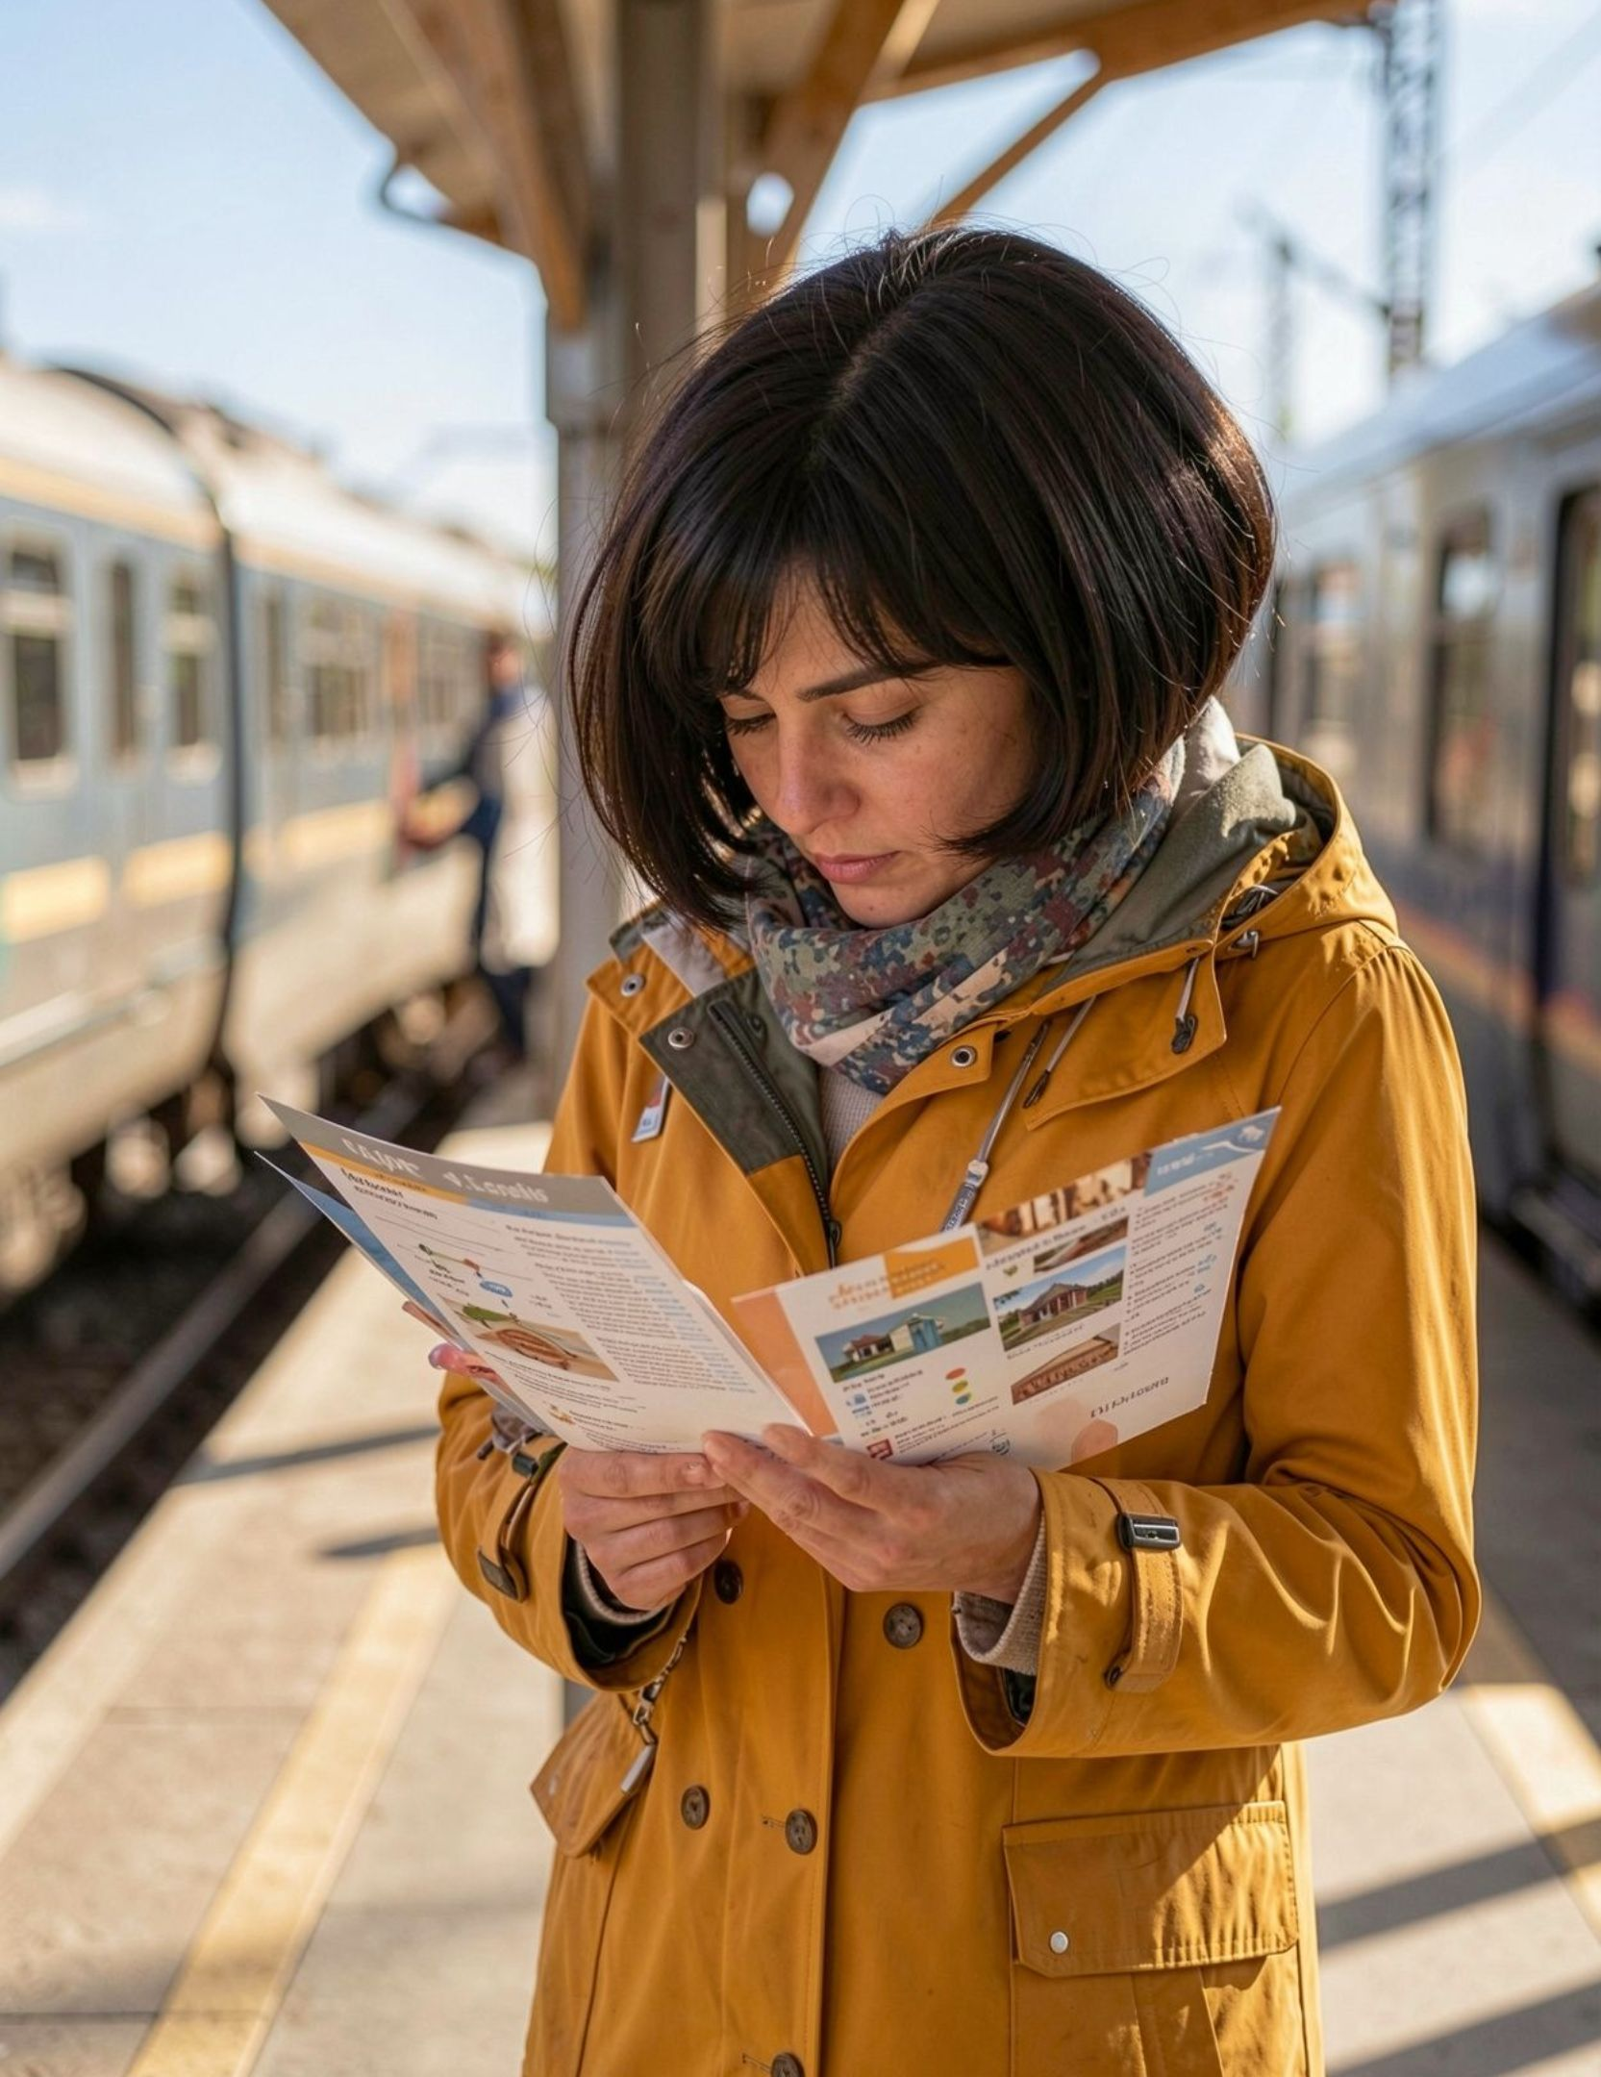
02 · USER NEED
DESIGN AROUND THE PASSENGER’S DECISIONS
Make route, date, train options, timing, fare, and availability easy to compare.
Keep the booking steps understandable on a phone as well as a larger screen.
Show clear progress and confirmation; treat accessibility, privacy, and trust as requirements to validate with users, not proven outcomes.
ORIENTED WITH SOCIETAL NEEDS · 10 POINTS
Notes:
Emphasize that the proposal is organized around passenger decisions, not around screens alone. Accessibility, privacy, trust, clear progress, and confirmation are requirements to validate with users, not proven outcomes.

Slide 4

03 · PROPOSED JOURNEY
THE PROPOSED FLOW MOVES FROM SEARCH TO BOOKING
REFERENCE JOURNEY · EXACT PROJECT SCOPE PENDING CONFIRMATION
Enter Trip
Compare Trains
Enter Passengers
Review & Book
An official e-ticket guide provides this as a reference journey; the proposed project’s exact scope remains to be confirmed.

Slide 5
04 · FEASIBILITY
FEASIBILITY DEPENDS ON ACCESS TO RELIABLE RAIL DATA
OPEN VALIDATION ITEMS · NOT COMPLETED ANALYSIS
Technical foundation
Dependencies to test
Still to define
A user interface, reservation logic, and dependable train, schedule, fare, and availability data are needed.
Data/API access
Secure handling of passenger details
Booking consistency
Payment integration if in scope
Technology stack, cost, schedule, and a test plan remain open validation items—not completed analysis.
REVIEW CRITERION · project feasibility analysis — 10 points

Slide 6
05 · DIFFERENTIATION
MAKE THE PROJECT’S NOVELTY SPECIFIC AND TESTABLE
DO NOT CLAIM NOVELTY BEFORE THE COMPARISON
01
02
03
[distinctive feature]
[passenger problem]
[test method]
The supplied project details do not yet identify a unique feature.
Define how the team will compare or test the differentiator.
State the specific passenger problem the feature addresses.
CHECK THE DIFFERENTIATOR AGAINST EXISTING BOOKING JOURNEYS · “NOVELTY OF THE PROJECT TITLE” · 10 POINTS

Slide 7
REVIEW CASE
Open with the purpose
Show the journey
PRESENT A CONCISE CASE, NOT AN UNBUILT DEMO
Start with the project title and one-sentence purpose.
Walk through the proposed booking journey with a diagram or wireframe.
Mark what is pending
Close with the test
Separate established requirements from decisions still to be validated.
End with the chosen differentiator and the next design or validation step.
CLARITY
10 points
SOCIETAL NEEDS
10 points
FEASIBILITY
10 points
NOVELTY
10 points
PRESENTATION
10 points
PROPOSAL, NOT PROTOTYPE

